Slide 1
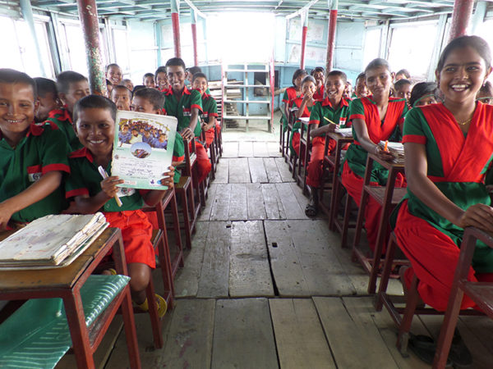
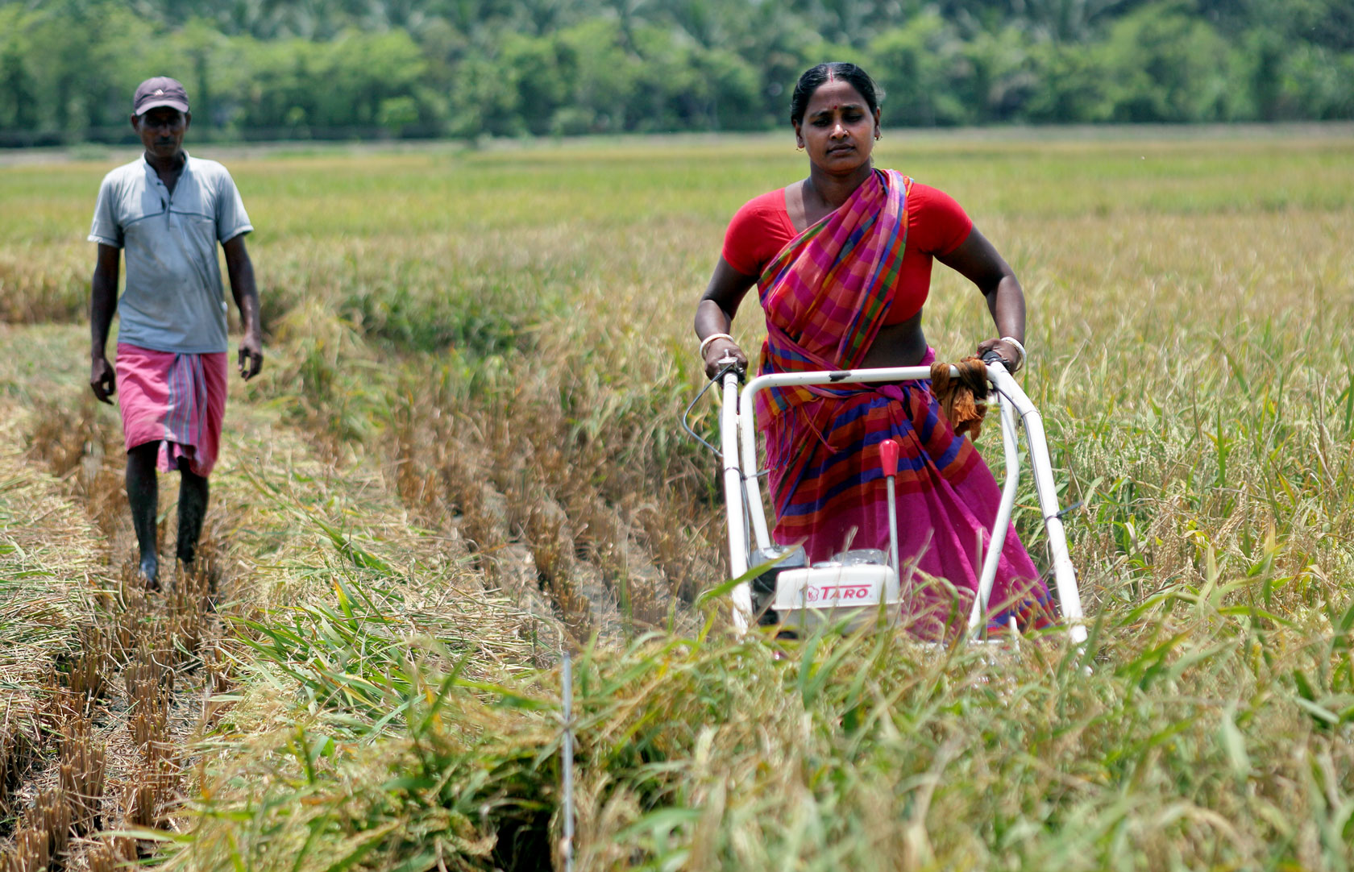
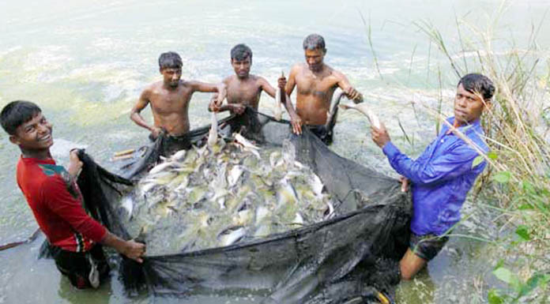
Greetings
from
Microcredit Regulatory Authority

Slide 2
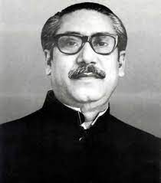
Inception of Microfinance in Bangladesh
The greatest Bengalee of all time, the father of the nation Bangabandhu Sheikh Mujibur Rahman Just after the independence of Bangladesh instructed to provide collateral and interest free micro/small loans to the marginalized people with a view to developing their fate as well as eradicating poverty of the country.
First interest and collateral free microcredit service was introduced in 1974 under a project named Rural Social Services (RSS).
In late 70s, along with their social development activities NGOs started demand driven Microfinance Operation.

Slide 3
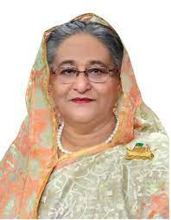
Background of MRA
1996: Hon’ble Prime Minister Sheikh Hasina just after coming to power gave proper importance for the development and policy formulation of MF sector.
1997: Study on “The regulatory Aspects of Microfinance Institutions (MFIs) and Linking it with the Formal Financial Sector” was conducted by Bangladesh Bank.
2011: Effective regulation started after passing the “Microcredit Regulatory Authority Rules, 2010”
2006: Parliament passed “Microcredit Regulatory Authority Act, 2006” and MRA started its operation 27 August 2006.
2000: Establishment of MRRU and formation of National Steering Committee with the chairmanship of the Governor of BB.

Slide 4
Licensing Information
Total Applications Received
= 6587
In 1st Phase
= 4243 (In 2006 )
In 2nd Phase
= 1212 (In 2012)
In 3rd Phase
= 1132 (In 2021)
Applications rejected
= 3483
License Issued
= 760
License Issued = 121
Assessment Completed
1079
(Except 53 companies)
Applications rejected
= 1091
Total License Issued = 882 (1 from newly applied
License Canceled for noncompliance = 151
Primary
Approvals
= 294
At present Licensed MFIs = 731

Slide 5
Division Wise Coverage
Division | Branches
Dhaka | 6149
Mymensingh | 1022
Chittagong | 4445
Rajshahi | 3955
Khulna | 3294
Rangpur | 2440
Sylhet | 769
Barishal | 1183

Slide 6
MFIs at a glance (June 2022)
Branches 23543
Employees 206713
Clients 38.27 million
Borrower 29.74 million
Savings 496.24 billion BDT
Loan Outstanding 1241.49 billion BDT
(Existing Loan to Borrower)
Loan Disbursement 1918.83 billion BDT
Loan Recovery 1652.69 billion BDT
MFIs 739

Slide 7
Growth of Credit & Savings
Year | 2008 | 2009 | 2010 | 2011 | 2012 | 2013 | 2014 | 2015 | 2016 | 2017 | 2018 | 2019 | 2020 | 2021 | 2022
Loan Disbursement (Tk. Billion) | 217.1 | 261.2 | 306.7 | 303.2 | 456 | 432.3 | 462 | 633.4 | 787 | 1033 | 1202 | 1403 | 1350 | 1511 | 1918
Loan Outstanding (Existing Loan to Borrower) (Tk. Billion) | 134.7 | 143.1 | 145 | 173.8 | 211.3 | 257 | 282.2 | 352.4 | 459.4 | 570.6 | 673.9 | 787.6 | 888.6 | 947.7 | 1241
Savings (Tk. Billion) | 47.38 | 50.61 | 51.36 | 63.3 | 75.25 | 93.99 | 107 | 135.4 | 171.2 | 217.9 | 263 | 306.1 | 373.9 | 422.1 | 496.2

Slide 8
Highlights of Microfinance Sector
Description | Member | Borrowers
 | (In Millions) | (In Million)
MRA licensed MFIS | 38.26 | 29.74
Grameen Bank | 9.93 | 6.84
Various Government Agencies | 6.43 | 1.94
Government and Non-Government Banks | 6.73 | 4.25
Total | 61.34 | 42.77

Slide 9
Highlights of Microfinance Sector
Description | Loan Outstanding (Billion BDT) | Savings (Billion BDT) | Loan disbursement (Billion BDT)
MRA licensed MFIS | 1241.5 | 496.24 | 1918.8
Grameen Bank | 145.94 | 232.65 | 206.57
Various Government Departments / Institutions / Special Programs | 56.48 | 28.05 | 39.75
Government and Non-Government Banks | 390.64 | 93.42 | 94.94
Total | 1834.53 | 850.36 | 2260.07

Slide 10
Sources of Fund as of June 2022

Slide 11
Microenterprise Loan Share (June 2022)

Slide 12
Agriculture Credit (54% of total Disbursement) (June 2022)

Slide 13
Important Achievements of MRA
Microcredit Regulatory Authority Rules, 2010 & it’s Amendments
Rationalize the rate of interest regarding loan (from 35% to 27% in 2010 and 24% in 2019) & savings (mini 6%)
Ensuring Grace Period (mini 15 days) and reducing Loan Processing cost (max TK 25)
Capital Raising by issuing Bond
Implementation of Annual Performance Agreement (APA) [Innovation, RTI, GRS, NIS and Citizen charter
National Microfinance Database (MF-NDB)
Digital mapping of Microfinance access points
MRA – যোগাযোগ
MRA-info App
Hot Line Number 16133
MF-CIB (Piloting Stage)
Integrated Microfinance Solutions (IMS)

Slide 14
Social Development Works
Education (Scholarship; Bangabandhu Higher Education Scholarship & Education for All)
Health (Hospital, Free Medical Checkup etc)
Awareness (Child Marriage, Dowry etc)
Sanitation (Handwash, Hygiene awareness etc)
Disaster management (Rehabilitation, Disaster response etc)
Covid 19 Response (Food, PPE, Mask, sanitizer, shelter etc)

Slide 15
COVID-19 Response (Microfinance)
Details of BDT 3000 crore Stimulus Package for low-income people Under BB Refinance Scheme (as on 13 July 2022)
Cumulative Refinance amount | BDT 2575.45 crore
Beneficiaries | Male | Female | Total
 | 56451 | 500319 | 556770
Involved Banks | 37
Involved MFIs | 153
Rate of Service Charge | 9%

Slide 16
Bangabandhu Higher Education Scholarship
Scholarship amount ranges from 3000-10000 BDT monthly
Scholarship offer to the talented poor in higher education under Public Universities & Medical Colleges
912 students financed by 107 MFIs till March 2022
Total amount of scholarship given in one year 66.51 million BDT

Slide 17
Salient features of Microcredit Regulatory Authority Act, 2006 & Microcredit Regulatory Authority Rules, 2010
License from MRA is mandatory for operation microfinance in Bangladesh [section 15(1)].
Operating microfinance without MRA license is criminal offence and punishable [section 35(1) (a) and (b), 35(2)].
Before applying for MRA license, interested organizations must be registered under any of the following Acts/Ord [section 2(21)]
The Societies Registration Act,1860
The Trust Act, 1882
The Company Act,1994
The Voluntary Social Welfare Agencies (Registration and Control) Ordinance, 1961
There will be a General Committee (GC) of minimum 15 to maximum 31 members having at least 2 women [rule 7(2)] and an Executive committee (EC) of minimum 5 to maximum 10 members having at least 2 women also [rule 8(2)].
No member of EC can continue his post more than 3 consecutive periods where each period will consist of 3 years respectively [rule 8(5)]
No salaried personnel can be the member of both EC & GC of MFI. Besides, a full time & salaried CEO should be appointed by EC and no staff can simultaneously work in more than one MFI [sec 27(1), rule 9(1) and sec 28(3)]

Slide 18
Cont’d
Family members such as father/mother-sun/daughter, husband-wife, full brother-full sister can’t be the chairman and CEO or bank signatory of an MFI at the same time [rule 10]
Authorized officials will be the bank signatories [rule 13(10)]
MFIs must have staff regulations as well as a pay scale [rule 12]
MFIs have to submit budget, Management Information System (MIS) report twice in a year and audit report once in a year [rule 39, rule 43, rule 47]
MFIs cannot collect deposit from non-clients as well as term deposit without MRA approval [section 32(1), rule 29]
70% of total clients must be provided with loan and maximum amount of savings of an MFI will be 80% of its outstanding loan [13(3)]
Short term liabilities especially deposit cannot be used for purchasing assets [rule 13(2), rule 35]
MFIs have to maintain reserve by 10% of their accumulated surplus [rule 20]. liquidity by 15% of their deposits [rule 34] and Loan Loss Provision (LLP) as per provision of rule [rule 44].
MFI shall maintain reconciliation report collecting its bank report in each Month [rule 42].
MFIs cannot distribute profit as dividend and allowed to use profit in maintaining statutory reserve, in revolving fund or in operating social activities for the clients’ welfare with prior approval of MRA [rule 21]

Slide 19
Important features of Issued 73 Circulars
Maximum rate of service (interest) charge will be 24% (dec) [circular-50]
Minimum 6% interest must be paid on deposit [circular -5]
There will be grace period of minimum 15 days and minimum 46 installments in case of weekly paid one year loan [circular -5,8]
Maximum miscellaneous cost (form, passbook, entry fee etc.) will be BDT 25 [circular -23]
Bad debt can be written off after 2 years from becoming as bad debt on condition of provisioning 100% LLP [circular -21]
Maximum 35% of Cumulative Surplus can be used for purchasing immoveable property [circular- 33, 47]
Fund like Disaster Management Fund (DMF) etc. can’t be formed with Microfinance service charge [circular-34]
No MFI will be allowed to maintain a liaison office with the microfinance Surplus & CEO shall discharge his duty staying at Head Office [circular -35]

Slide 20
Cont’d
Ensuring the implementation of the provisions of the Money Laundering Prevention Act, 2012 and relevant rules & regulations
MRA shall be informed about the leave substitute of CEO due to foreign tour and only microfinance operation related expenditure following govt rules can be borne [circular -46]
Prior approval shall be taken in case of purchasing land/Flat and vehicles [circular -47]
Prior approval shall be taken for spending accumulated surplus for social work as per given format [circular -48]
After completion of the financial year hard copies (print copy) of both General Ledger and Cash Book shall be maintained from the software [circular -52]
Loan classification can’t be deteriorated on 31/12/2020 from 01/01/2020 and charge 1% of the total loan amount of 31/12/2020 as LLP [circular -59]
Policy on Financing of Microcredit Institutions by Microfinance Institutions, 2022. [circular -73]

Slide 21
Challenges
Fund Shortage of Small & Medium MFIs;
Reducing Operational Cost;
Shortage of skilled Manpower of MFIs;
Unlawful Microfinance Operation;
Lack of Clients’ Financial Literacy;
Ensuring Regulation irrespective of MFI’s size;
Introduction of DFS & Digitalization.

Slide 22
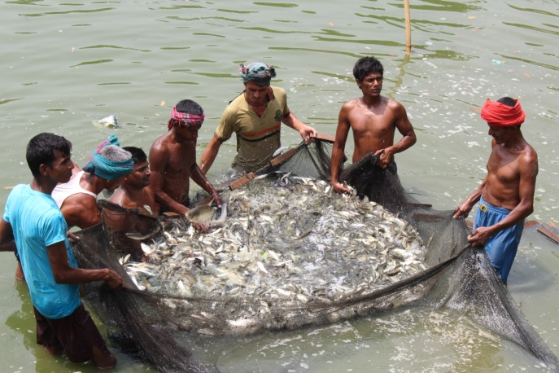
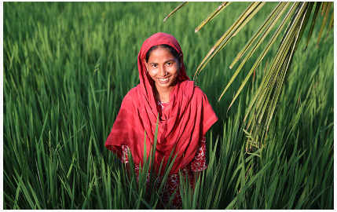
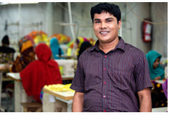
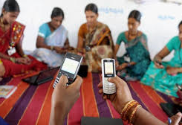
Thank You

